Slide 1

PREVIEW MY WORK
SOCIAL MEDIA
Web: CourtneyJamesMarketing.com
LinkedIn: www.linkedin.com/in/courtney-james/
Email: CourtneyJamesWriting@gmail.com

Slide 2



EXAMPLES FOR B2B AUDIENCES

Slide 3

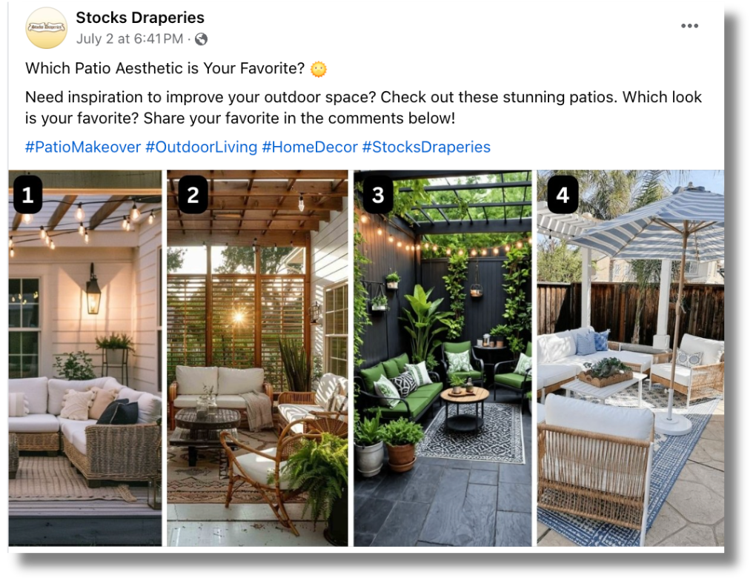
EXAMPLES FOR B2C AUDIENCES

Slide 4
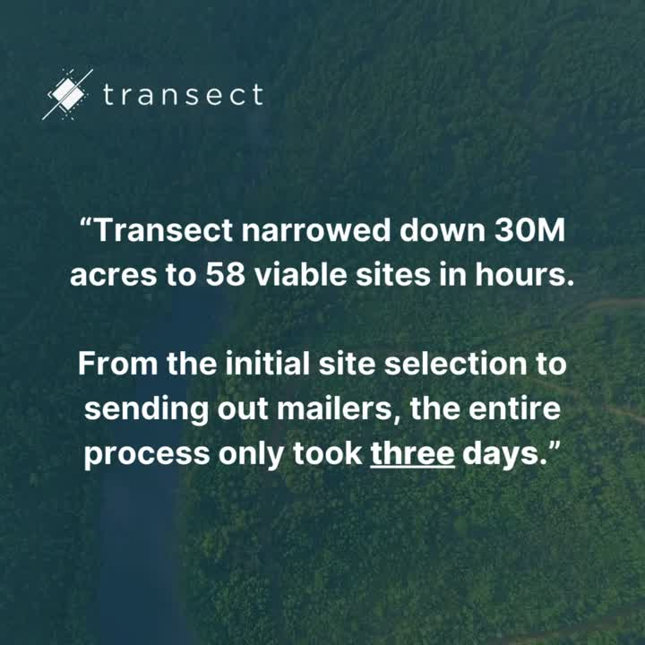

SOCIAL VIDEOS

Slide 5
HAVE QUESTIONS OR WANT TO LEARN MORE?
CONNECT WITH ME TODAY!
Web: CourtneyJamesMarketing.com
LinkedIn: www.linkedin.com/in/courtney-james/
Email: CourtneyJamesWriting@gmail.com

